Slide 1
Analyzing Attribute Data

Slide 2
Types of Logistic Regression:
A Single Independent Variable Model is called as Simple Logistic Regression
Logistic Regression
Simple
Multiple
A Multiple Independent Variable Model is called as Multiple Logistic Regression

Slide 3
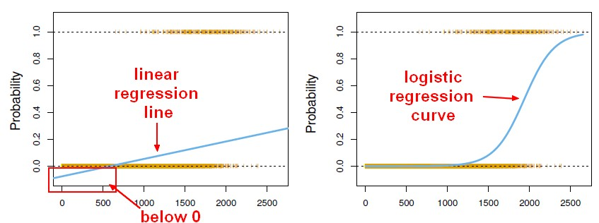
Logistic Regression:
Logistic Regression
Logistic Regression model predicts the probability associated with each dependent variable Category.
How does it do this?
It finds linear relationship between independent variables and a link function of this probabilities. Then the link function that provides the best goodness-of-fit for the given data is chosen

Slide 4
Logistic Regression
Multiple Logistic Regression Model is quite similar to the Multiple Linear Regression Model, Only β coefficients vary.
Where,
β₀ = the y axis intercept
β_{i} = the model coefficient for the linear effect of variable i on y
e = the random error

Slide 5

Logistic Regression
Probability:
The probability in a logistic regression curve:
Where,
‘e’ is a real number constant, the basic of natural logarithm and equals 2.7183
‘y’ is the response value for an observation

Slide 6
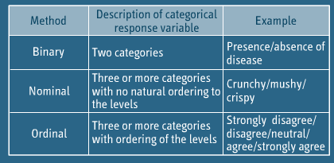
Logistic Regression Methods

Slide 7
Assumptions in Logistic Regression
1
2
Only one outcome per event – Like pass or fail
The outcomes are statistically independent
3
All relevant predictors are in the model
4
One category at a time – Mutually exclusive & collectively exhaustive
5
Sample sizes are larger than for linear regression

Slide 8
Steps in Logistic Regression
1
2
Collect & organize sample data
Formulate Logistic Regression Model
3
Check the model’s validity
4
Determine Probabilities using Probability equation
5
Compile the results

Slide 9
Regression Techniques - Simple Logistic Regression
Y = Discrete
Y = Discrete
Create Dummy Variable
X = Single & Continuous
X = Single & Discrete
Simple Logistic Regression
Simple Logistic Regression

Slide 10
Logistic Regression Example
Imagine that you are a Data Scientist at a very large scale integration circuit manufacturing company. You want to know whether or not the time spent inspecting each product impacts the quality assurance department’s ability to detect a designing error in the circuit
Step-1: Collect and organize the sample data
Number of Observations
Error Identification
Inspection Time
Number of Observations: 55 Observations of circuits with errors, and determine whether those errors were detected by QA

Slide 11
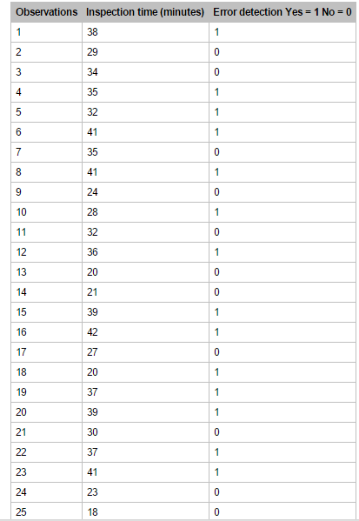
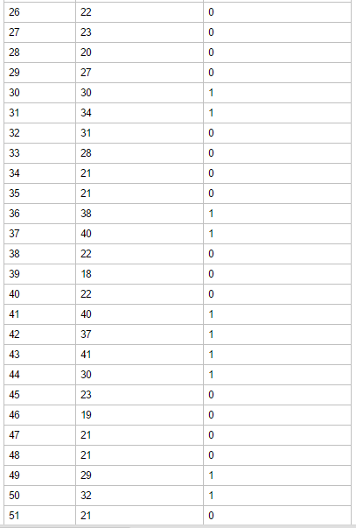


Slide 12

Example:
Step-2: Formulate Logistic Regression Model
The Logistic regression equation is derived from any statistical software
Step-3: Check model’s validity
Check model’s validity involves performing Hypothesis testing, or validations.
Creating Logistic Regression Tables
Logistic Regression Table:
Logistic Regression Table shows the estimated coefficients, standard error of the Coefficients, Z Statistics and p-values.

Slide 13
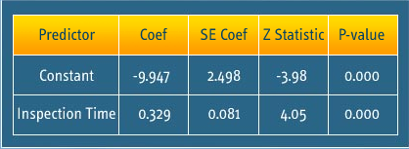
Example:
Logistic Regression Table:
The important thing about the table is p-value is 0.00 which is less than alpha value 0.05, this indicates that regression coefficients are not 0, and there is a significant relationship between the independent variable, -Inspection time and the dependent variable- error detection.

Slide 14
Example:
Goodness-of-fit test Using Pearson Method:
Chi-Square Statistics – 7.6831
Degree of Freedom – 20
p-value – 0.608
p-value indicates that there’s insufficient evidence to reject the null hypothesis that the model fits the data adequately
Logistic Regression Equation
Determining Probabilities using Probability equation
Probability equation
e = 2.7183

Slide 15
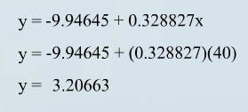
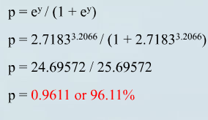
Example:
Interpretation: Probability 96.11% indicates that the error will be detected if QA spent 40 minutes of inspection during an observation.

Slide 16
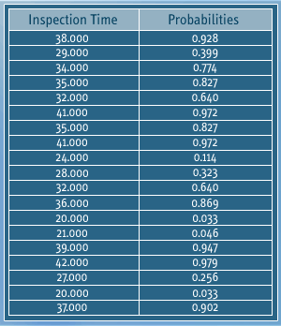
Example:
Step-5: Compile the Results
This example deals with simple logistic regression model with one dependent variable and one independent variable. The same rule applies for Multiple Logistic Regression.

Slide 17
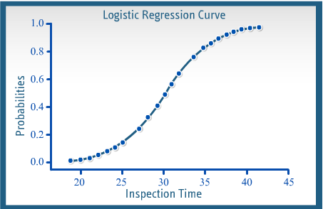
Example:
Step-5: Compile the Results

Slide 18
Confusion Matrix
Disease Present
Disease Absent
Test
positive
True positive
False positive
Test negative
False negative
True negative

Slide 19
Confusion Matrix
Predicted Class
Test +ve
Test -ve
Disease Present
TP
FN
Actual
Class
Disease Absent
FP
TN
True Positive (TP) = Patient with disease is told that he/she has disease
True Negative (TN) = Patient with no disease is told that he/she does not have disease
False Negative (FN) = Patient with disease is told that he/she does not have disease
False Positive (FP) = Patient with no disease is told that he/she has disease
Overall error rate = (FN+FP) / (TP+FN+FP+TN)
Accuracy = 1 – Overall error rate OR (TP+TN) / (TP+FN+FP+TN); Accuracy should be > % of majority class

Slide 20
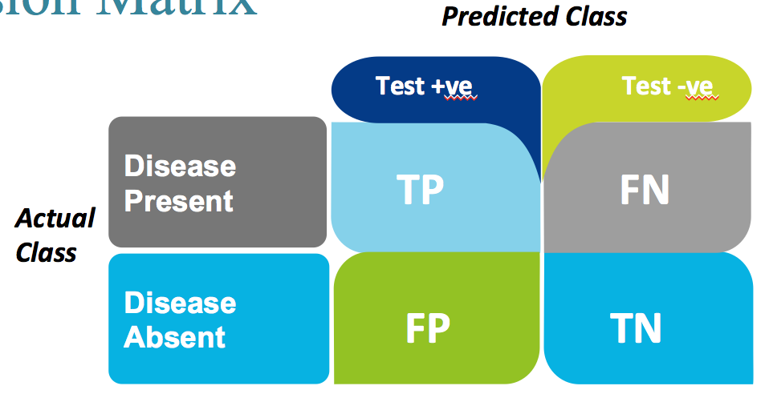
Confusion Matrix
Precision = TP/(TP+FP) = TP/Predicted Positive = Prob. of correctly identifying a random patient with disease as having disease
Sensitivity (Recall or Hit rate or True Positive Rate) = TP/(TP+FN) = TP/Actual Positive = Proportion of people with disease who are correctly identified as having disease
Specificity (True negative rate) = TN/(TN+FP) = Proportion of people with no disease being characterized as not having disease
FP rate (Alpha or type I error) = 1 – Specificity
FN rate (Beta or type II error) = 1 – Sensitivity
F1 = 2 * ((Precision * Recall) / (Precision + Recall))
F1: 1 to 0 & defines a measure that balances precision & recall

Slide 21
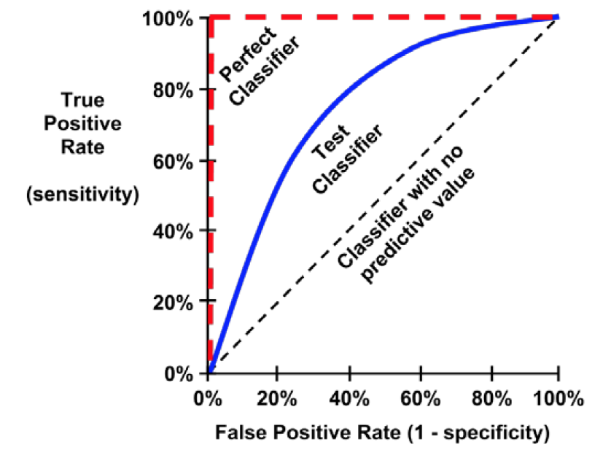
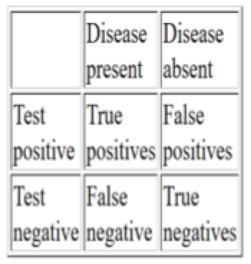
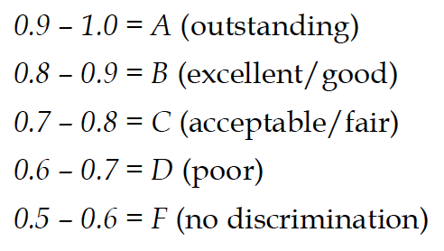
ROC – Receiver Operating Characteristic
History is WW II to differentiate between true signals & false alarms
Choose cutoff point which maximizes the true positive & minimizes the false negative

Slide 22
Thank You

